Slide 1
AfriHub
A digital increase social connection for youth
By :
Joselyne Nisingizwe
Angelique Niyitegeka
Esther Nikuze
Josiane Karikumutima

Slide 2
Problem statement
In Africa , youth are facing different challenges in accessing the right career information , getting opportunities and being loneliness.
They don’t have acquired soft skills and enough connection, enough resources in order to compete to the global job market.
Digital Healing has missed to those that need support virtual.
Beyond that, Many youth especially fresh graduate doesn’t have soft skills acquired while applying and searching opportunities.
We have identified that their biggest challenge they meet is being missing various opportunities and that make them extremely loneliness.
Social inclusion and access to information is a human right and we want to solve the puzzle.
Women youth are still few in tech industry

Slide 3

Innovation and solution
For all the mentioned faced problems We have come up with a solution called AfriHub site.
It is a one in all platform ,a site that will help youth get more opportunities ,connect among them ,develop their soft skills.
As women youth are still few in tech industry ,this will be a chance to motivate them by giving testimonies, Sharing the achievement, accomplishment and showing self-confidence among them .
This will increase the smartness and professional skills of youth in our country .
This solution will help youth to participate in the development of the society as well as in the increase of our country economic revenue.
This will be a place where youth will chart and talk among each other
They will have virtual demo day ,healing support, learning space and debate .

Slide 4
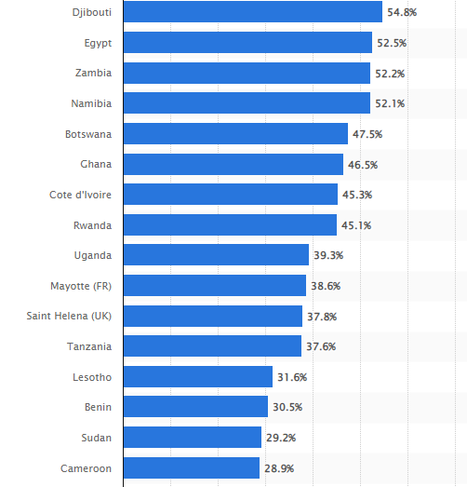
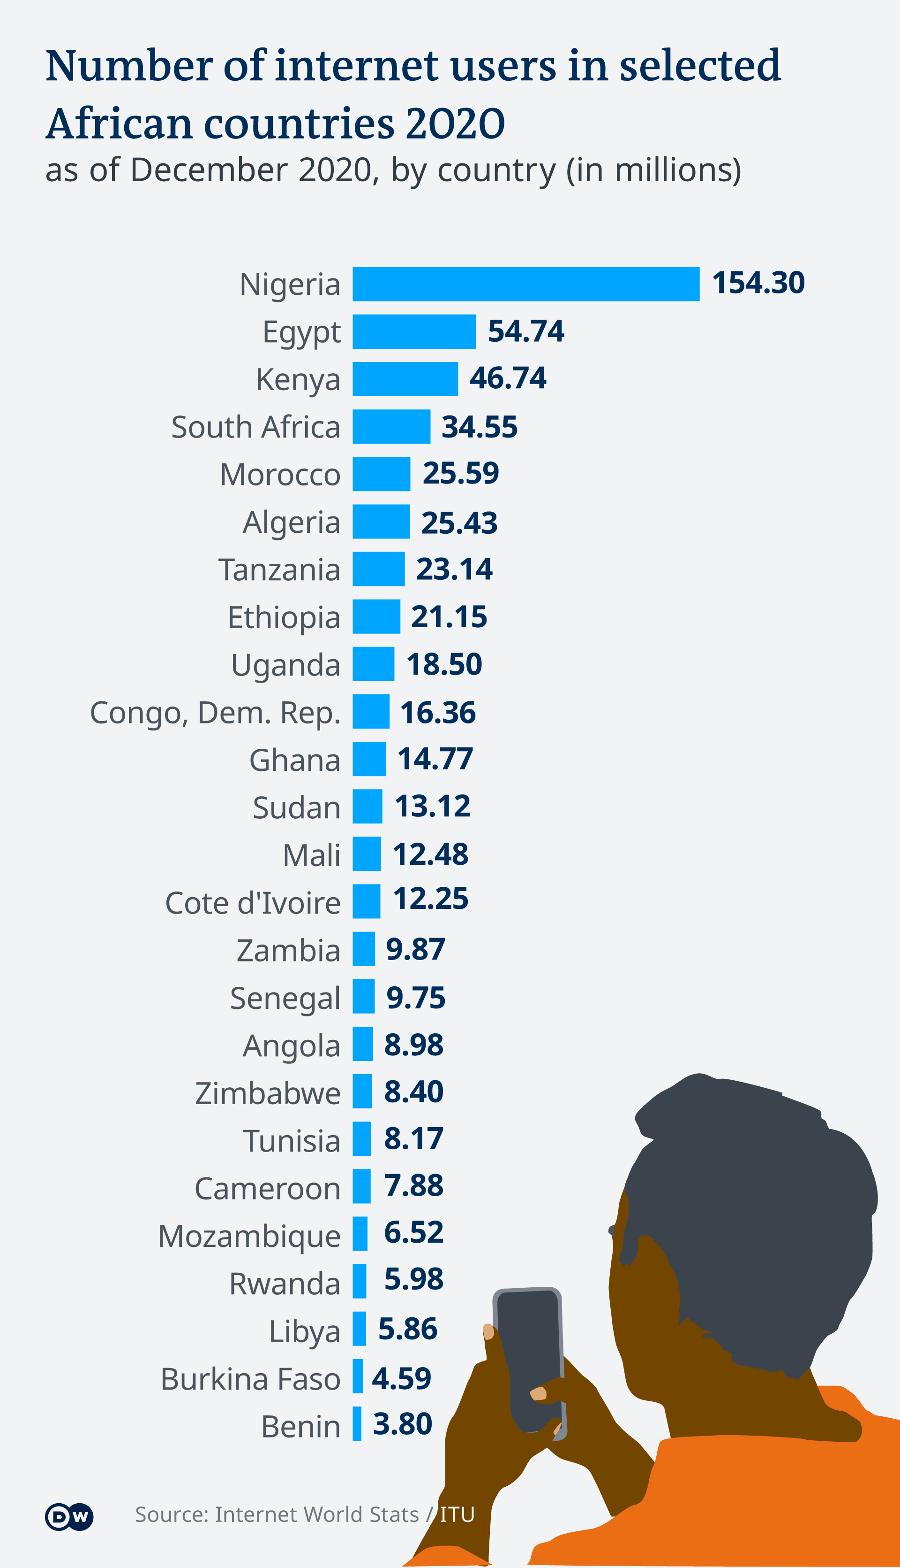
Youth in social participation

Slide 5
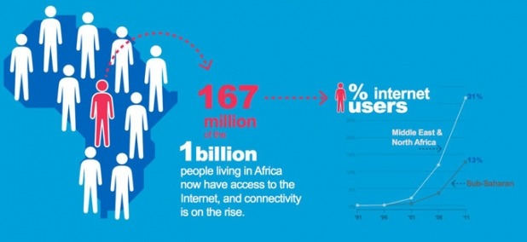
Social connection users

Slide 6
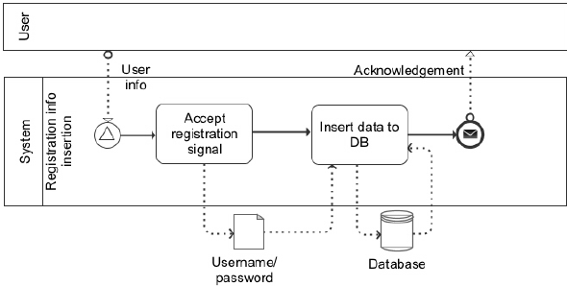
Product Design

Slide 7
Market and business model
The World Development Report 2019 notes that the labor market of the future will require new skills including digital fluency, creative thinking, problem-solving, collaboration, empathy and adaptability. With these new demands in place, it would be remiss of Africa not to strengthen her biggest asset: the youth who make up around 60% of the continent’s population.
In order to prepare the youth for the digital economy and the future of work by using social connection :
United Nation Global Assembly noted that 2030 Agenda as the blueprint to achieve a better and more sustainable future for all which are 17 Social Development Goals(SDGs)
Economic Growth
Inclusion in youth

Slide 8
System Future plan
Technology for our Better bright future
Robot as Artificial Intelligence (AI)for the role such as:
Chat box
Healing support
Data manipulation

Slide 9
Team
Angelique Niyitegeka
Teacher and Accounting
Josiane Karikumutima
Engineer ,a developer and Quality assurance
Esther Nikuze
IT
Joselyne Nisingizwe
A developer and business analyst

Slide 10
Thanks
Stay Safe

